Slide 1
OOPS PROJECT GUI [ GRAPHICAL USER INTERFACE ] HOTEL BOOKING

Slide 2









INTRODUCTION
ABSTRACT
PROJECT QUESTION
GUI
CLASS DIAGRAMS
SCREENS ANALYSIS
OUTPUT SCREENS
ANALYSIS
FUTURE ENCHANCEMENTS
CONCLUSION

Slide 3
ABSTRACT
This project is about HOTEL MANAGEMENT . We used GUI ( GRAPHICAL USER INTERFACE ) to do this project. Many people among us love travelling , but booking our stay at the hotels in offline mode becomes difficult. So at that period of time we become clueless to what to do. So here is our project helpful for those people who can’t book their stay at a hotel in a offline mode. Here in this project we take some inputs such like name , DOB , address , age , ID proof , gender , check in date , check out date , type of room and display a confirmation message as an output when the booking is completed. This online hotel booking is very easy and helpful as pre booking will be available. So this project has been done on the bases of GUI.

Slide 4
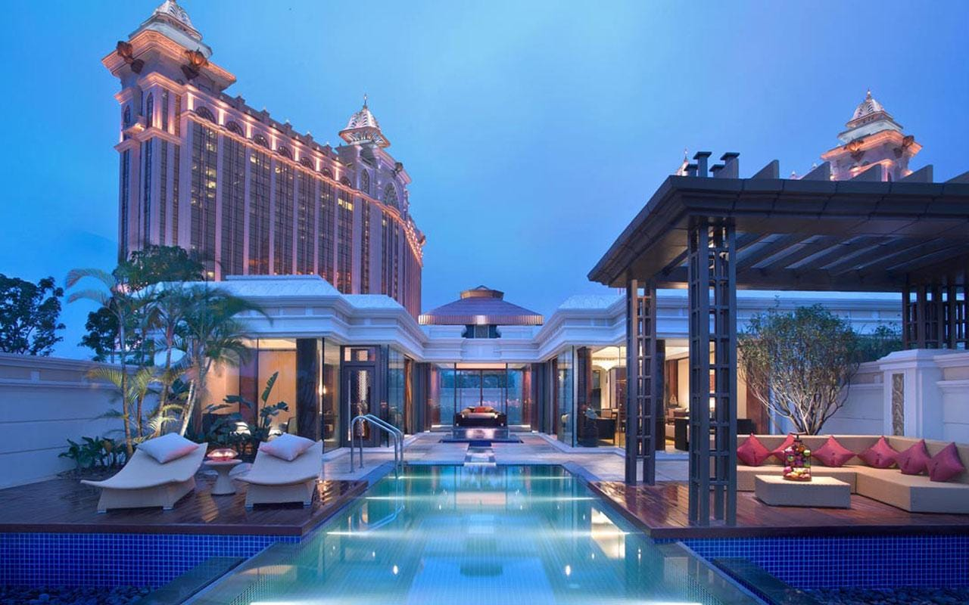
PROJECT QUESTION
Your friend is a manager of a Five-star hotel and has been asked by his hotel’s stakeholders to digitalize the process of booking a stay in that hotel for the customers. Develop a GUI based program for your friend such that it takes in the details of the customer (name, age, gender, check-in date, check-out date, no of people and their preference of room). Verify all the details and display a confirmatory message on the screen and then store the details in a file.

Slide 5
GUI
GRAPHICAL USER INTERFACE
A graphical user interface (GUI) is a type of user interface through which users interact with electronic
devices via visual indicator representations
A GUI (graphical user interface) is a system of interactive visual components for computer software. A GUI displays objects that convey information, and represent actions that can be taken by the user. The objects change color, size, or visibility when the user interacts with them.
A GUI includes GUI objects like icons, cursors, and buttons. These graphical elements are sometimes enhanced with sounds, or visual effects like transparency and drop shadows. Using these objects, a user can use the computer without having to know commands.

Slide 6
4
CUSTOMER DETAILS
Address , mobile , number of adults , number of children
STAY DETAILS
Type of room , date in , date out , number of beds, ac or non ac
LOGIN SCREEN
Username , password
5
2
1
3
4
6
SIGN UP SCREEN
Name , age , password , mobile , gender
CUSTOMER DETAILS
Name , DOB , gender , type of id proof , id proof details.
BOOKING CONFIRMATORY MESSAGE

Slide 7
VISTA HOTEL
VISTA HOTEL
VISTA HOTEL
+name : string
+age : int
+password : string
+mobile : long int
+gender : char
+name : string
+dob : string
+gender : char
+typeofidproof : char
+idproofdetails : string
+username : string
+password : string
+getusername : string
+getpassword : string
+getname() : string
+getdob() : string
+getgender() : char
+gettypeofidproof() : char
+getidproofdetails() : string
+getname(): string
+getage(): int
+getpassword(): string
+getmobile(): long int
+getgender(): char

Slide 8
VISTA HOTEL
VISTA HOTEL
+address : string
+mobile : long int
+no.ofadults : int
+no.ofchildren : int
+roomtype : char
+datein : string
+dateout : string
+no.ofbeds : int
+acornonac : char
+getaddress() : string
+getmobile() : long int
+getno.ofadults (): int
+getno.ofchildren() : int
+getroomtype() : char
+getdatein() : string
+getdateout() : string
+getno.ofbeds (): int
+getacornonac() : char

Slide 9
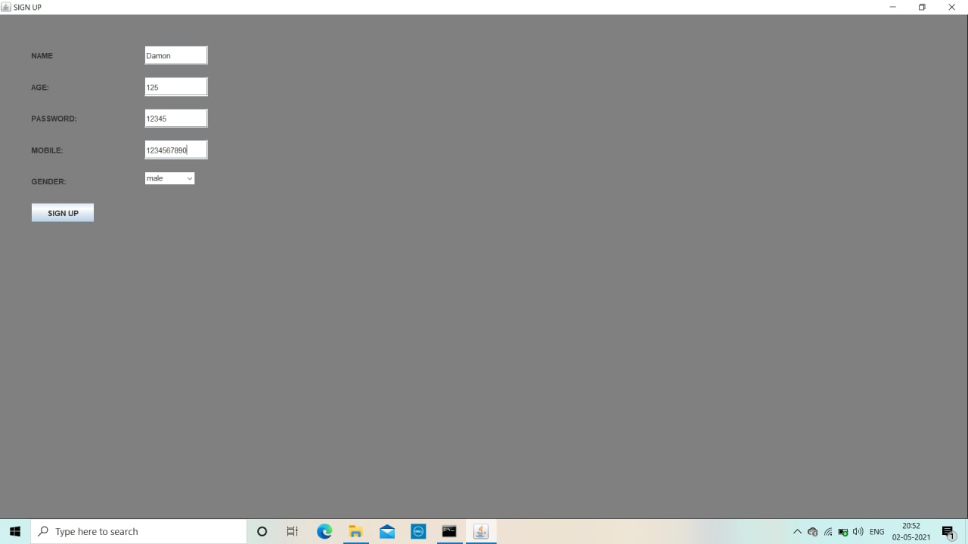
OUTPUT SCREENS

Slide 10
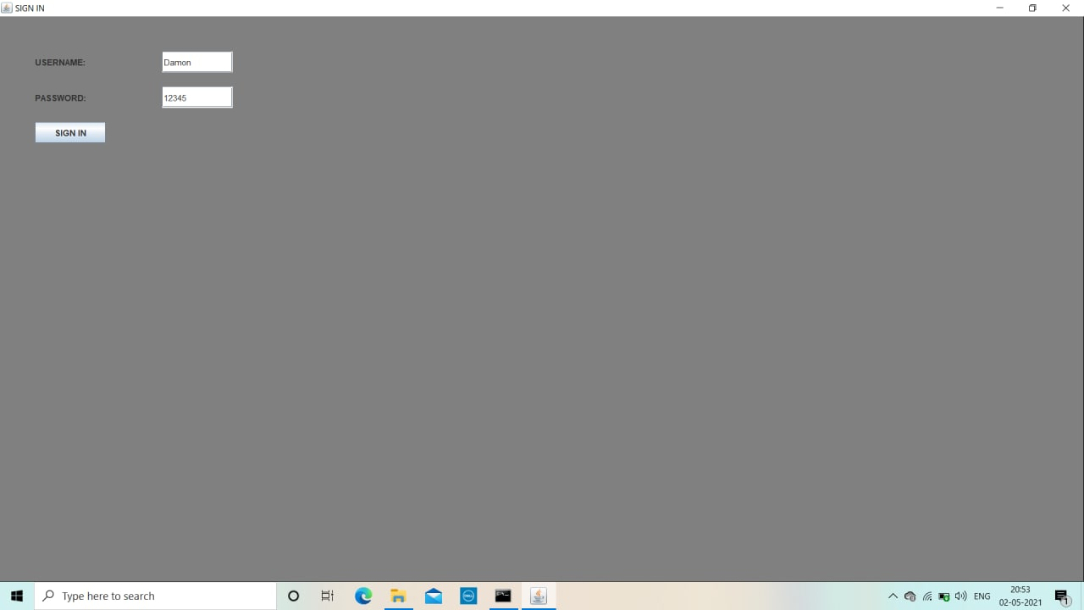

Slide 11
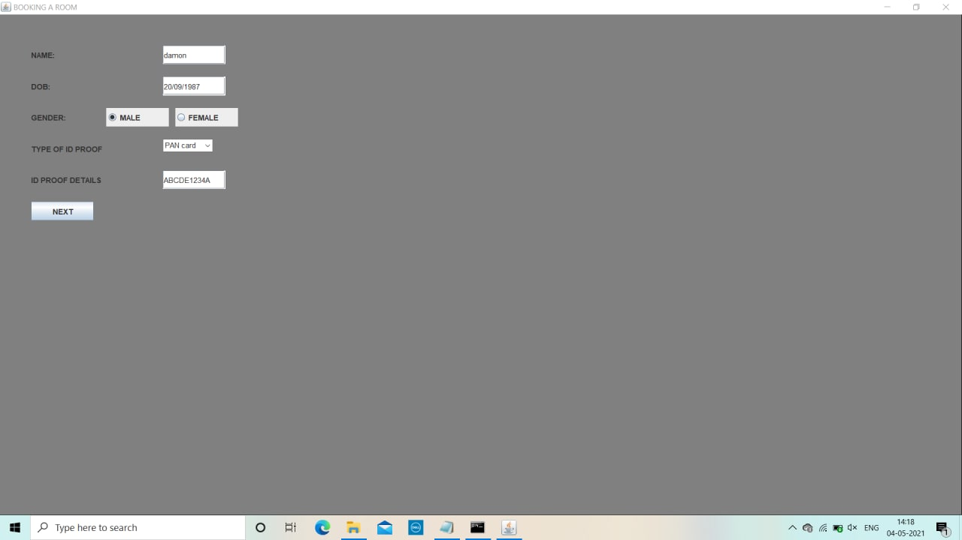

Slide 12
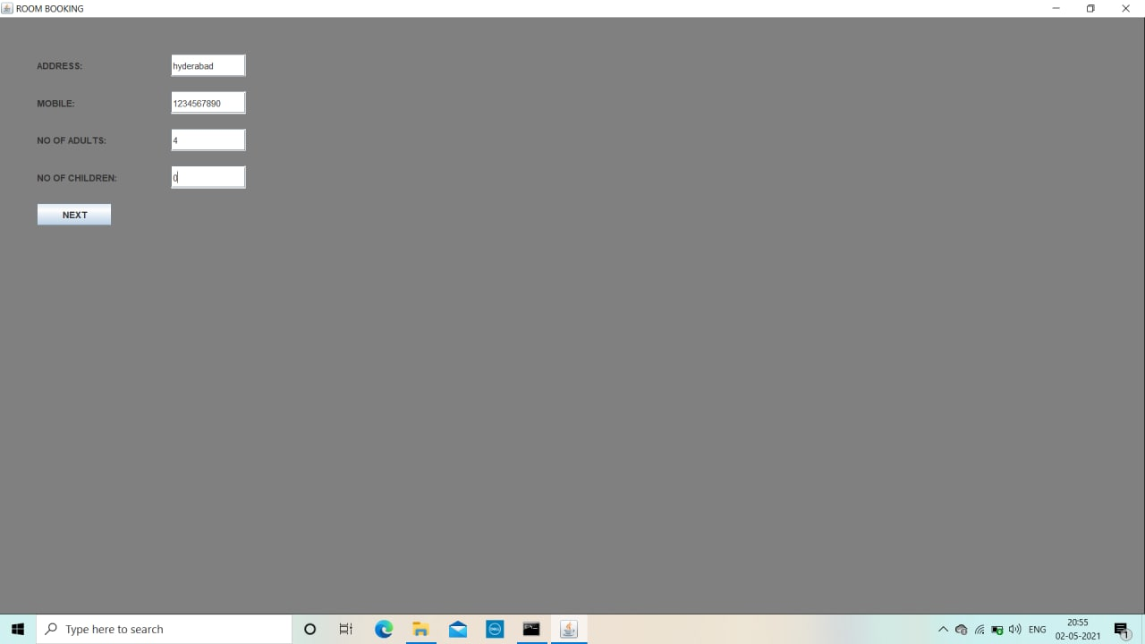

Slide 13
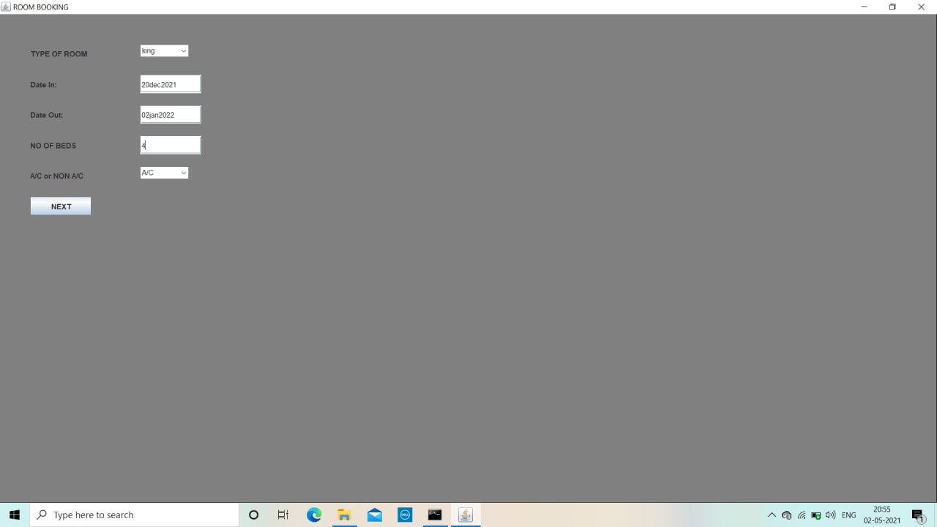

Slide 14
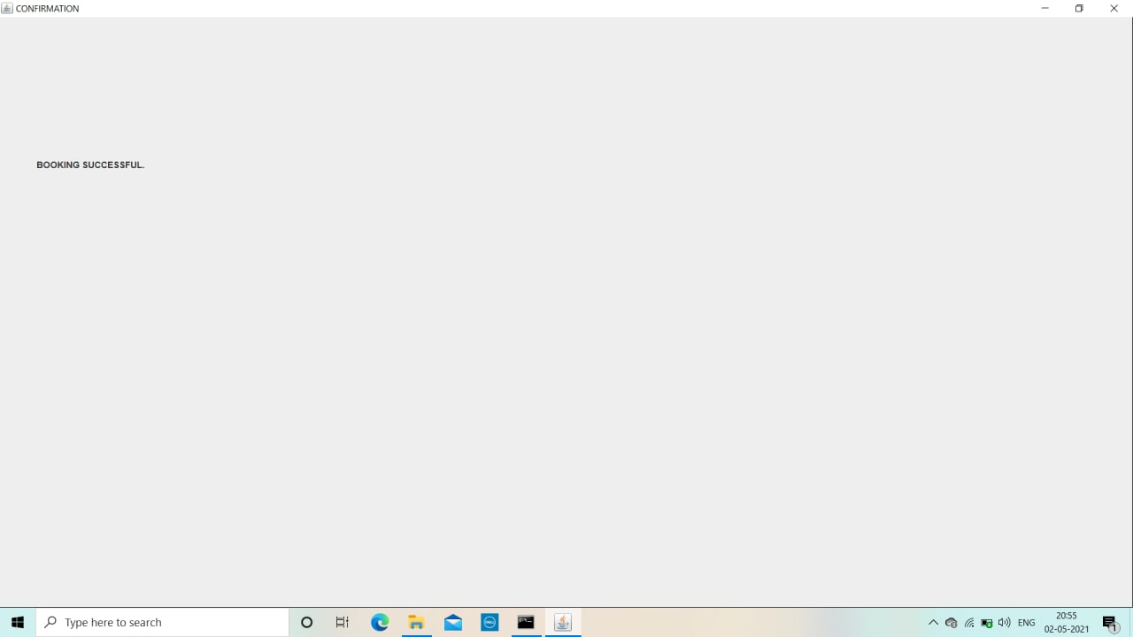

Slide 15
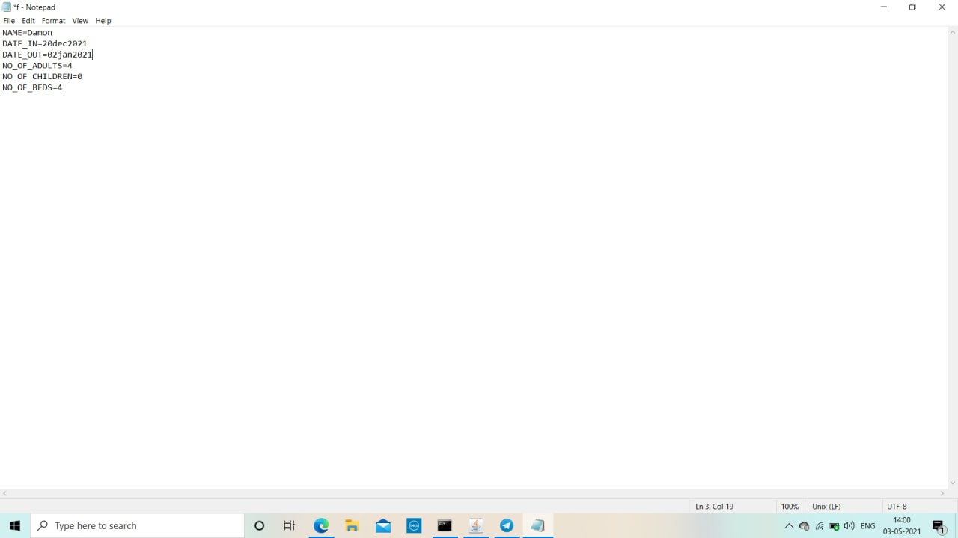

Slide 16
REPORT ON THE MONITERING OF ONLINE AND OFFLINE HOTEL BOOKING

Slide 17
FUTURE ENCHANCEMENTS
We can make this project more helpful by adding more categories and features which can help the customers by sorting their requirements in an easy way.
Last minute bookings are trending, especially in today’s COVID-19 reality. So far, travelers tend to book travel and hotel deals at a moment’s notice, not well in advance. So last minute bookings can be added to make it easy for the customers.
We can use a customer’s contact details and help them gain discounts and add credits to their accounts so that they can redeem those credits and book their rooms with special discount.

Slide 18
CONCLUSION
We have used GUI to do this project. We have taken customer details like name , DOB , gender, age , ID proof , check in dates, check out dates , number of adults , number of children , mobile number etc. and displayed a confirmation message about the status of booking a room at VISTAHOTEL. This hotel management project is very useful to book their room in online mode.

Slide 19
THANK YOU

